Slide 1
Refugees & Mental Health

Slide 2
1 in 200
1 in 3
2x
Children in the world is a refugee
Children living outside their country of birth is a refugee
As many child refugees in 2015 than in 2005

Slide 3
Action Goals
Protect
Prevent violence and exploitation by strengthening child protection systems.
End Detention
Create alternatives to the detention of refugee and migrant children to prevent damaging psychological impact.
Keep Families Together
Keep children from being separated from their parents during border control processing and any migrant legal processes.
Access to Learning & Health
Provide education, health, shelter, nutrition, water and sanitation, and access to legal support to migrant children.
Press for Action
Change the underlying causes of large scale movements of refugees and migrants.
Combat marginalization
Promote measures to combat xenophobia and discrimination in countries of transit and destination.

Slide 4
Access to Learning & Health
Nutrition
Health
Legal, psychosocial support
Shelter
Provide Education
Sanitation
Notes:
An increased collective effort by governments, communities and the private sector is needed to provide education, health, shelter, nutrition, water and sanitation, and access to legal and psychosocial support to these children. This is not only a collective responsibility, it is in all societies’ common interests. A child’s migration status should never represent a barrier to accessing essential services.

Slide 5
Let’s Watch A Video!

Slide 6
https://www.ted.com/talks/essam_daod_how_we_can_bring_mental_health_support_to_refugees#t-301872

Slide 7
A small action
Send words of support to a refugee!

Slide 8
https://www.care.org/get-involved/letters-hope

Slide 9
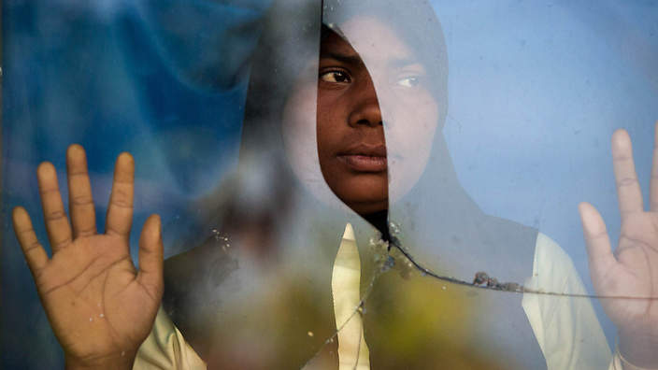
Discussion

Slide 10
What can you do to help?
Come to Unicef Unite on Tues. Nov 13 @ 7 p.m!
Write to your legislators!
Fundraise with us!

Slide 11
THANKS!
Any questions?
I’ll happily research/talk to you about any questions or ideas you may have about child refugees/migrants
...or reach out if you want a link to any info I used!

Slide 12
Opportunities
Reach Out To Us!!!
Education Piece ideas?
Anything you’d like to teach us about??
Email us or come up to me after the meeting!
Notes:
*get a picture

